Slide 1


Artem Kutepov
09.10.2023

Slide 2

Outline
Executive Summary - 3
Introduction - 5
Methodology - 10
Results - 22
Conclusion - 56
Appendix

Slide 3
Executive Summary
Perform data wrangling
Modify and add columns, useful for training models
Perform exploratory data analysis (EDA) using visualization and SQL
Perform interactive visual analytics using Folium and Plotly Dash
Perform predictive analysis using classification models:
Break dataset into training and test data
Develop various models (KNN, Decision Tree, etc…) using train data
Assess accuracy scores of models and their best parameters using test data

Slide 4
Executive Summary
SpaceX’s successful recoveries generally have the following properties:
A launch date in the year 2017 or later
Light payload (in the range 2000-4000kg)
Launched from site KSC LC-39A
Successfully recovered via drone ship
Our machine learning model can predict the outcome of a given recovery with a reasonable degree of accuracy, 83.33%

Slide 5
Introduction
Most pace exploration companies may spend up to $165 million per rocket launch
With their flagship Falcon 9 rocket, SpaceX has cut down this cost to only $62 million per launch
How?

Slide 6
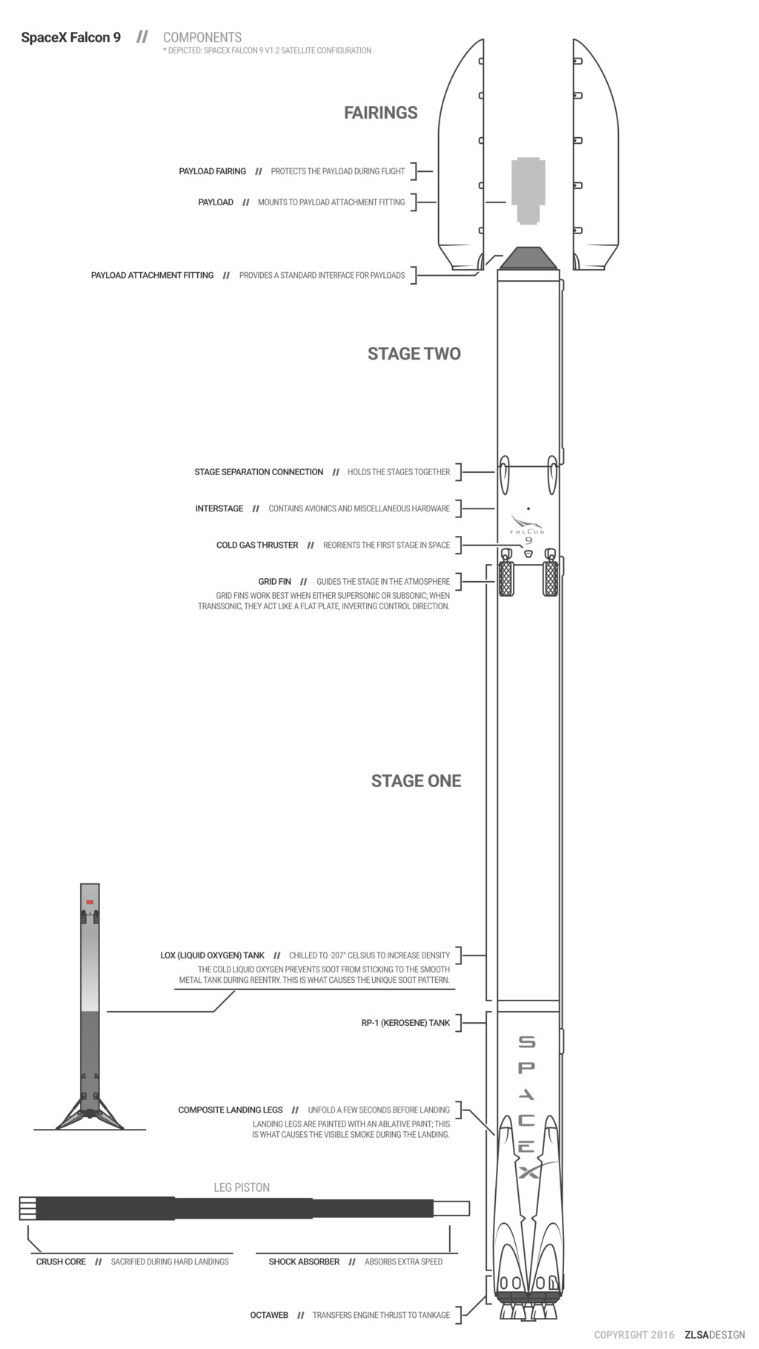
Introduction
It’s not rocket science!
With the Falcon 9, SpaceX is able to recover and reuse Stage One, a large and expensive component of the rocket
Recovery of Stage One means drastically reduced manufacturing costs
(Created by - Forest Katsch, zlsadesign.com)

Slide 7

Introduction
Of course, a successful Stage One recovery is not guaranteed..

Slide 8
Introduction
The outcome of a landing will have a significant effect on the overall cost of a launch
So, we will be training machine learning models to predict whether or not a SpaceX Stage One recovery will be successful
With this knowledge, we will be able to copy the aspects of successful recoveries with our own SpaceY rockets and ensure that we will be able to save millions

Slide 9

Section 1

Slide 10
Methodology
Data collection methodology:
Collect rocket launch data from SpaceX API
Perform data wrangling
Modify and add columns, useful for training models
Perform exploratory data analysis (EDA) using visualization and SQL
Perform interactive visual analytics using Folium and Plotly Dash
Perform predictive analysis using classification models
Break dataset into training and test data
Develop various models (KNN, Decision Tree, etc…) using train data
Assess accuracy scores of models and their best parameters using test data

Slide 11
Data Collection
To collect our data, we need to:
Download a .json file containing rocket launch data from the SpaceX API
Parse the information into a dataframe
Convert null values of quantitative variables into the mean of the rest of the column

Slide 12
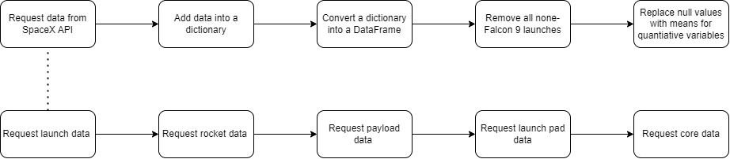
Data Collection – SpaceX API
Link to GitHub repo

Slide 13
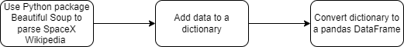
Data Collection - Scraping
Link to GitHub repo

Slide 14
Data Wrangling
A key point of this project is to determine whether a recovery was successful or not
So how do we distinguish between «successful» or «unsuccessful»?
According to our dataframe, there are 8 different outcomes, each of which can be considered a Success or Failure:
True ASDS → Successful landing to drone ship
True RTLS → Successful landing on a ground pad
True Ocean → Successful landing in ocean
None None → Failed to land
None ASDS → Failed to land
False ASDS → Failed to land on drone ship
False RTLS → Failed to land on ground pad
False Ocean → Failed to land in ocean

Slide 15
Data Wrangling
From here, we could create a new column, «class», to delineate between successful and unsuccessful recoveries:
1 → successful recovery
0 → unsuccessful recovery
• From here, we are ready to do some more advanced EDA

Slide 16

Data Wrangling
Link to GitHub repo

Slide 17
EDA with Data Visualization
Here, a number of plots showing relationships between different variables:
Flight Number vs. Payload (Cat plot)
Flight Number vs. Launch Site (Cat plot)
Launch Site vs. Payload (Scatter plot)
Success Rate vs. Orbit type (Bar plot)
Orbit type vs. Flight Number (Scatter plot)
Orbit type vs. Payload (Scatter plot)
Success rate vs. Time in years (Line plot)
An explanation of these various plots are shown in Section 2
We also perform some one-hot encoding in this section
Link to GitHub repo

Slide 18
EDA with SQL
Using bullet point format, summarize the SQL queries you performed
Add the GitHub URL of your completed EDA with SQL notebook, as an external reference and peer-review purpose

Slide 19
Build an Interactive Map with Folium
Summarize what map objects such as markers, circles, lines, etc. you created and added to a folium map
Explain why you added those objects
Add the GitHub URL of your completed interactive map with Folium map, as an external reference and peer-review purpose

Slide 20
Build a Dashboard with Plotly Dash
Summarize what plots/graphs and interactions you have added to a dashboard
Explain why you added those plots and interactions
Add the GitHub URL of your completed Plotly Dash lab, as an external reference and peer-review purpose

Slide 21
Predictive Analysis (Classification)
Summarize how you built, evaluated, improved, and found the best performing classification model
You need present your model development process using key phrases and flowchart
Add the GitHub URL of your completed predictive analysis lab, as an external reference and peer-review purpose

Slide 22
Results
Exploratory data analysis results
Interactive analytics demo in screenshots
Predictive analysis results

Slide 23

Section 2

Slide 24
Flight Number vs. Launch Site
Show a scatter plot of Flight Number vs. Launch Site
Show the screenshot of the scatter plot with explanations

Slide 25
Payload vs. Launch Site
Show a scatter plot of Payload vs. Launch Site
Show the screenshot of the scatter plot with explanations

Slide 26
Success Rate vs. Orbit Type
Show a bar chart for the success rate of each orbit type
Show the screenshot of the scatter plot with explanations

Slide 27
Flight Number vs. Orbit Type
Show a scatter point of Flight number vs. Orbit type
Show the screenshot of the scatter plot with explanations

Slide 28
Payload vs. Orbit Type
Show a scatter point of payload vs. orbit type
Show the screenshot of the scatter plot with explanations

Slide 29
Launch Success Yearly Trend
Show a line chart of yearly average success rate
Show the screenshot of the scatter plot with explanations

Slide 30
All Launch Site Names
Find the names of the unique launch sites
Present your query result with a short explanation here

Slide 31
Launch Site Names Begin with 'CCA'
Find 5 records where launch sites begin with `CCA`
Present your query result with a short explanation here

Slide 32
Total Payload Mass
Calculate the total payload carried by boosters from NASA
Present your query result with a short explanation here

Slide 33
Average Payload Mass by F9 v1.1
Calculate the average payload mass carried by booster version F9 v1.1
Present your query result with a short explanation here

Slide 34
First Successful Ground Landing Date
Find the dates of the first successful landing outcome on ground pad
Present your query result with a short explanation here

Slide 35
Successful Drone Ship Landing with Payload between 4000 and 6000
List the names of boosters which have successfully landed on drone ship and had payload mass greater than 4000 but less than 6000
Present your query result with a short explanation here

Slide 36
Total Number of Successful and Failure Mission Outcomes
Calculate the total number of successful and failure mission outcomes
Present your query result with a short explanation here

Slide 37
Boosters Carried Maximum Payload
List the names of the booster which have carried the maximum payload mass
Present your query result with a short explanation here

Slide 38
2015 Launch Records
List the failed landing_outcomes in drone ship, their booster versions, and launch site names for in year 2015
Present your query result with a short explanation here

Slide 39
Rank Landing Outcomes Between 2010-06-04 and 2017-03-20
Rank the count of landing outcomes (such as Failure (drone ship) or Success (ground pad)) between the date 2010-06-04 and 2017-03-20, in descending order
Present your query result with a short explanation here

Slide 40

Section 3

Slide 41
<Folium Map Screenshot 1>
Replace <Folium map screenshot 1> title with an appropriate title
Explore the generated folium map and make a proper screenshot to include all launch sites’ location markers on a global map
Explain the important elements and findings on the screenshot

Slide 42
<Folium Map Screenshot 2>
Replace <Folium map screenshot 2> title with an appropriate title
Explore the folium map and make a proper screenshot to show the color-labeled launch outcomes on the map
Explain the important elements and findings on the screenshot

Slide 43
<Folium Map Screenshot 3>
Replace <Folium map screenshot 3> title with an appropriate title
Explore the generated folium map and show the screenshot of a selected launch site to its proximities such as railway, highway, coastline, with distance calculated and displayed
Explain the important elements and findings on the screenshot

Slide 44

Section 4

Slide 45
<Dashboard Screenshot 1>
Replace <Dashboard screenshot 1> title with an appropriate title
Show the screenshot of launch success count for all sites, in a piechart
Explain the important elements and findings on the screenshot

Slide 46
<Dashboard Screenshot 2>
Replace <Dashboard screenshot 2> title with an appropriate title
Show the screenshot of the piechart for the launch site with highest launch success ratio
Explain the important elements and findings on the screenshot

Slide 47
<Dashboard Screenshot 3>
Replace <Dashboard screenshot 3> title with an appropriate title
Show screenshots of Payload vs. Launch Outcome scatter plot for all sites, with different payload selected in the range slider
Explain the important elements and findings on the screenshot, such as which payload range or booster version have the largest success rate, etc.

Slide 48

Section 5

Slide 49
Classification Accuracy
Visualize the built model accuracy for all built classification models, in a bar chart
Find which model has the highest classification accuracy

Slide 50
Confusion Matrix
Show the confusion matrix of the best performing model with an explanation

Slide 51
Conclusions
Point 1
Point 2
Point 3
Point 4
…

Slide 52
Appendix
Include any relevant assets like Python code snippets, SQL queries, charts, Notebook outputs, or data sets that you may have created during this project

Slide 53


